Slide 1
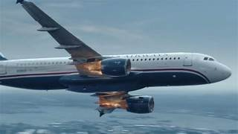
Mitigating Bird Strikes in Aviation
SUBMIT BY - ANNAMALAI G MENTOR - Mr. MUNNA PANDEY

Slide 2
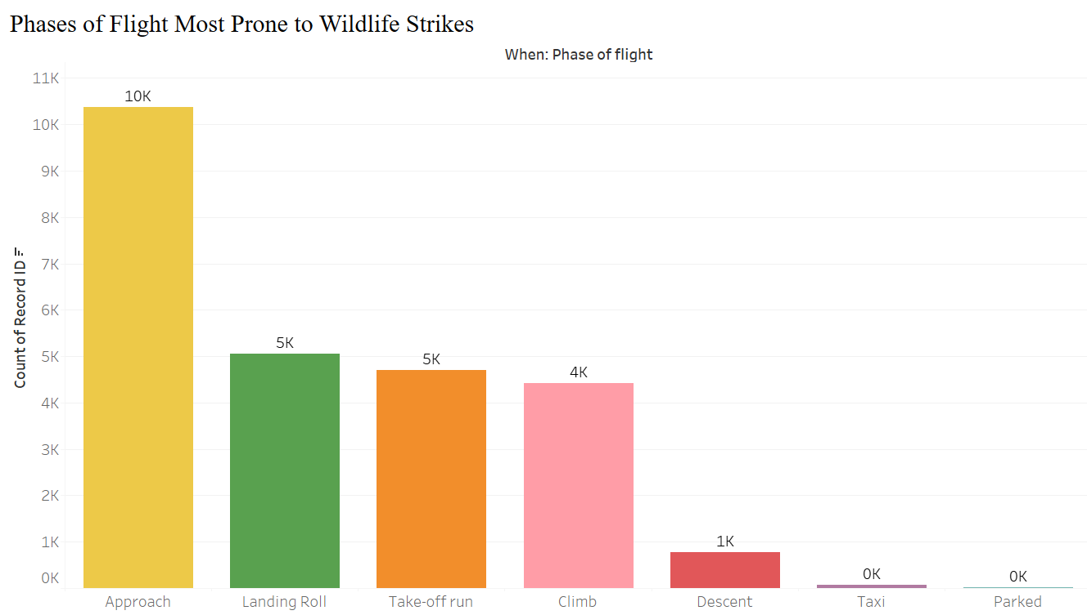
Project analysis slide 2
Safety Improvement
During which phases of flight are wildlife strikes most likely to occur?
• The visualization shows that the approach phase of flight is most prone to wildlife strikes, followed by the landing roll phase.
• The take-off run and climb phases also have a significant number of incidents. Descent, taxi, and parked phases have considerably fewer incidents.

Slide 3

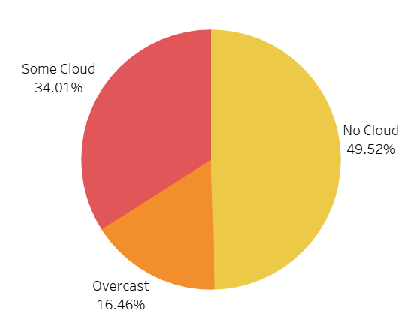
Project analysis slide 2
Safety Improvement
How were the sky conditions during hits?
• The pie chart illustrates the distribution of sky conditions during bird strikes.
• The majority of strikes (49.52%) occurred under No Cloud conditions, followed by Some Cloud (34.01%) and Overcast conditions (16.46%).

Slide 4
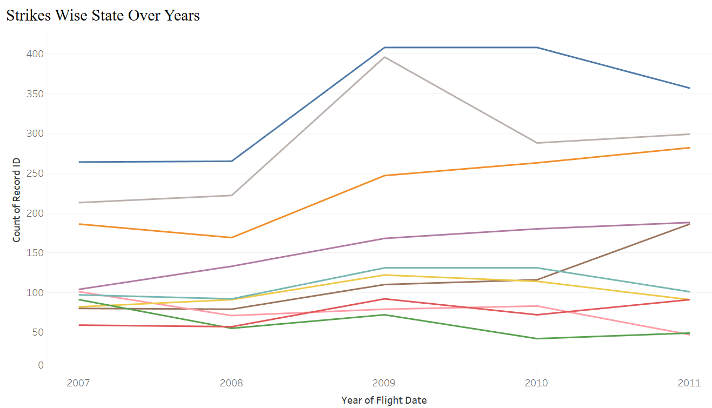
Project analysis slide 2
Safety Improvement
How are the strikes occurred in a state over the year ?
• The visualization shows the trend of wildlife strikes across different states over the years 2007 to 2011.
• Some states, like California, Alaska, and Florida, consistently have a high number of strikes throughout the years. Other states, such as Idaho, Illinois, and Indiana, have relatively fewer strikes.

Slide 5
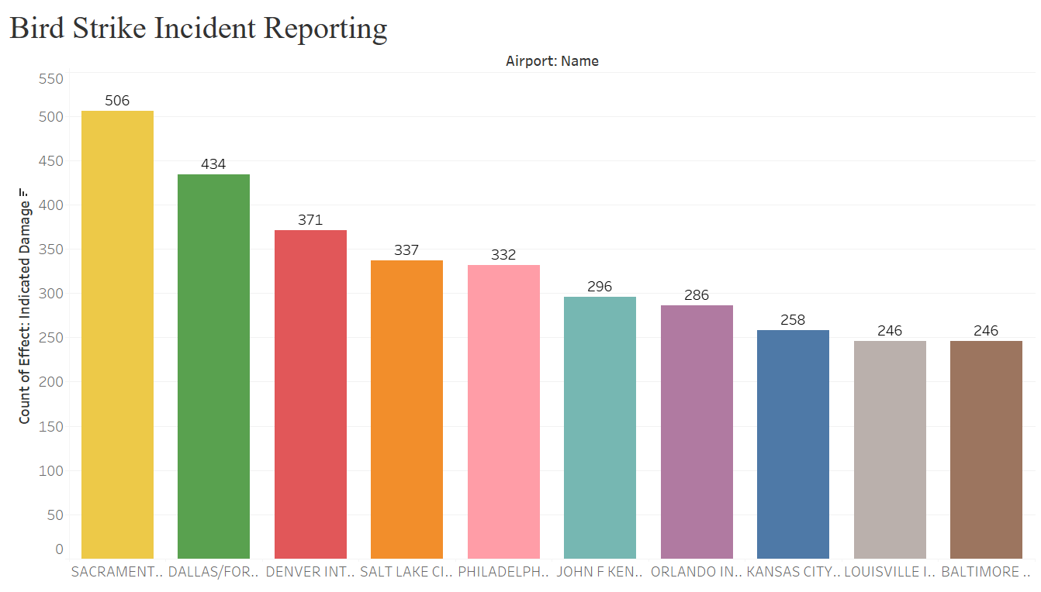
Project analysis slide 2
Regulatory Compliance
How accurately & promptly are bird strike incidents reported in compliance with aviation safety regulation
• The visualization shows the number of bird strike incidents at various airports.
• It's clear that Sacrament International Airport has the highest number of reported incidents, followed by Dallas International Airport.

Slide 6
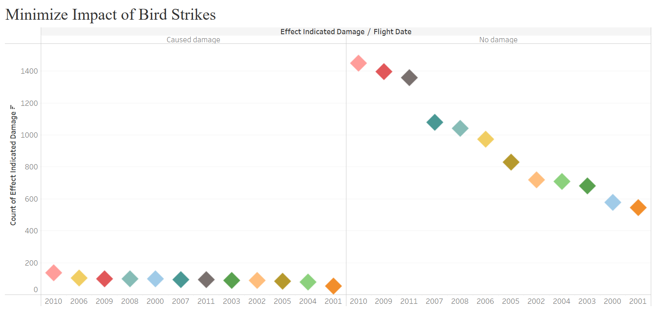
Project analysis slide 2
Operational Efficiency
Can we optimize fight schedules to minimize the impact of bird strikes on operations?
• The visualization shows the trend of bird strike incidents over the years, categorized by the damage caused.
• The majority of incidents resulted in no damage to the aircraft

Slide 7
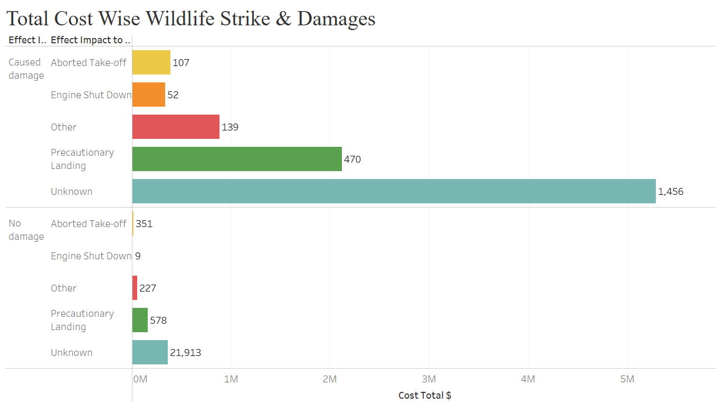
Project analysis slide 2
Cost Reduction
What is the total cost associated with wildlife strikes, including damages ?
• The visualization shows the total cost associated with different types of wildlife strikes.
• The majority of the total cost is attributed to incidents with an unknown impact on flight operations, highlighting the need for improved data collection and reporting

Slide 8
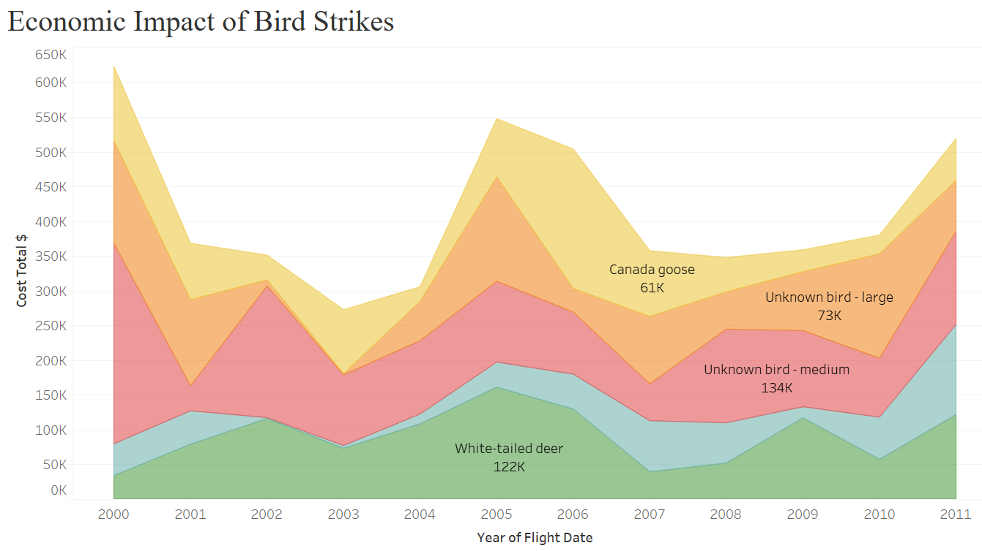
Project analysis slide 2
Cost Reduction
Are the cost-effective preventive mesure that can be implemented to reduce the economic impact of bird strikes
• This visualization shows the economic impact of bird strikes caused by different wildlife species over the years.
• It reveals that Canada Geese and Unknown Birds (Large) have consistently caused the highest costs.

Slide 9
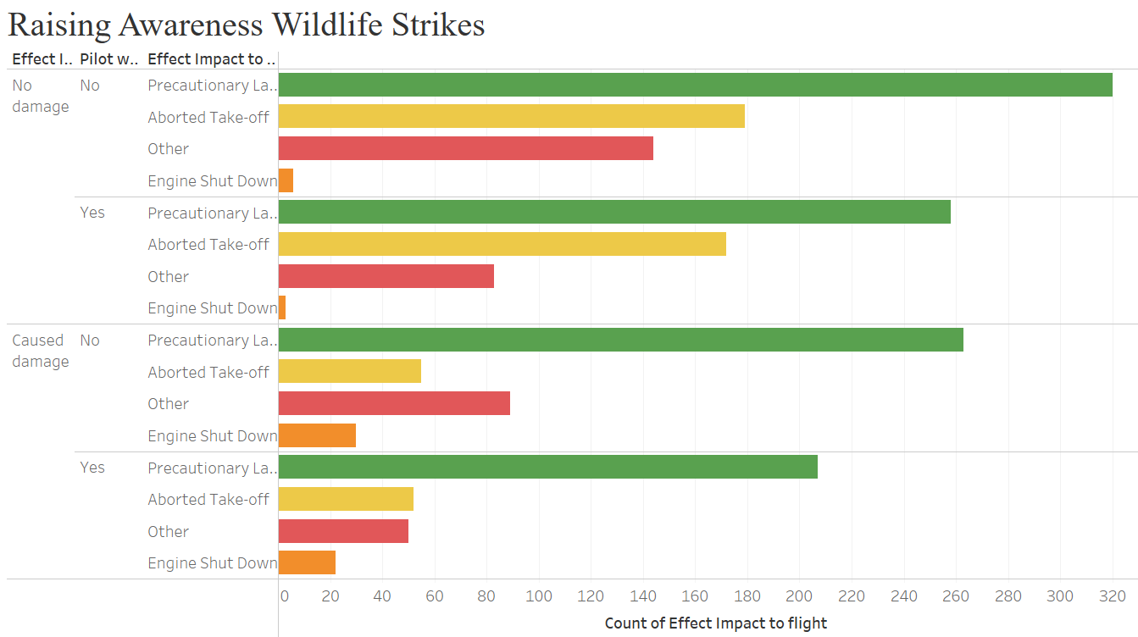
Project analysis slide 2
Communication & Training
How effective are current pilot training program in raising awareness about wildlife strikes?
• The visualization shows the bird strike incidents categorized by pilot was warned of birds and the impact on the flight.
• A significant number of incidents occurred even when pilots were warned of birds, highlighting the challenges in preventing bird strikes

Slide 10
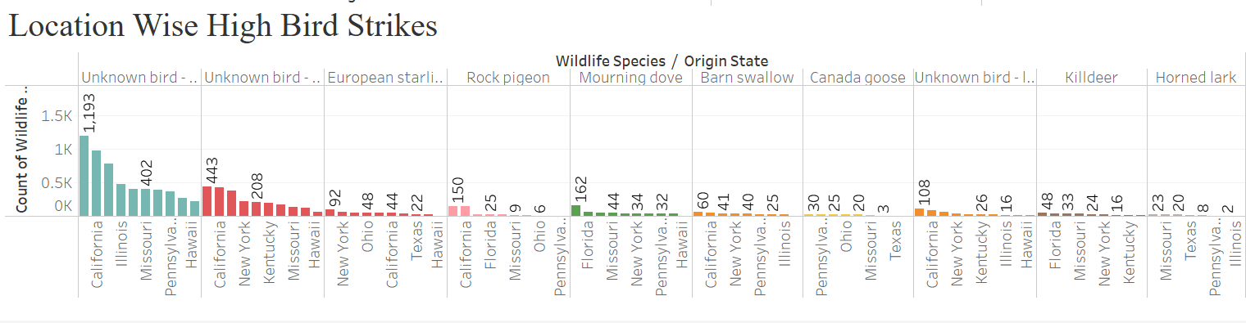
Project analysis slide 2
Operational Efficiency
Are there Specific routes or location where the risk of bird strikes is higher ?
• This visualization shows the top states with the highest number of bird strikes, categorized by different wildlife species.
• California stands out as the state with the highest number of bird strikes across various species.
• Other states like Illinois, Missouri, and New York also have a significant number of bird strikes

Slide 11
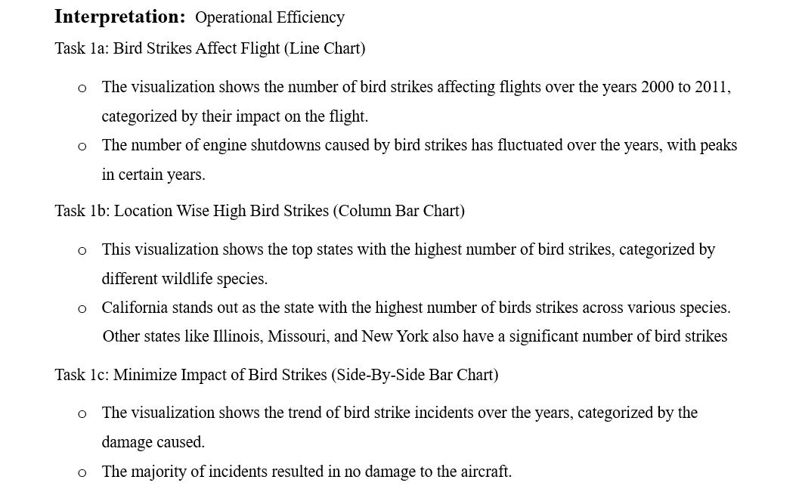
Project analysis slide 2
Mitigating Bird Strikes in Aviation

Slide 12
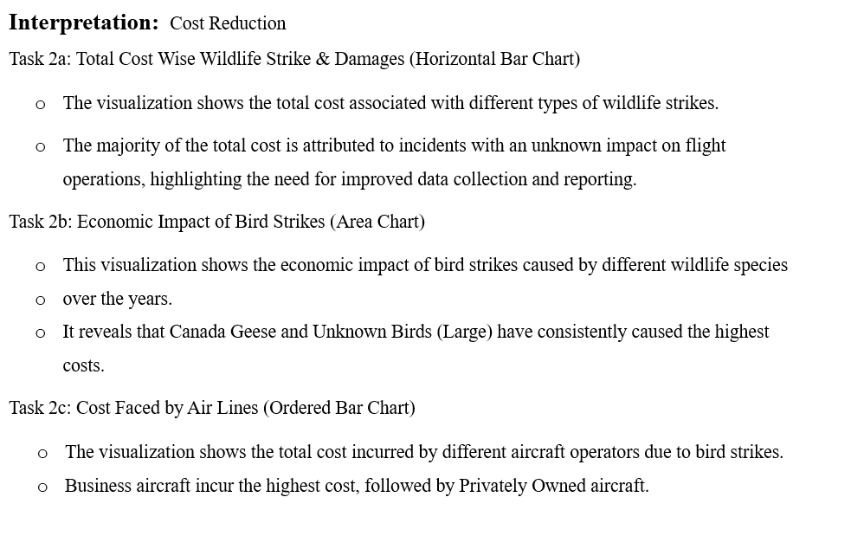

Slide 13
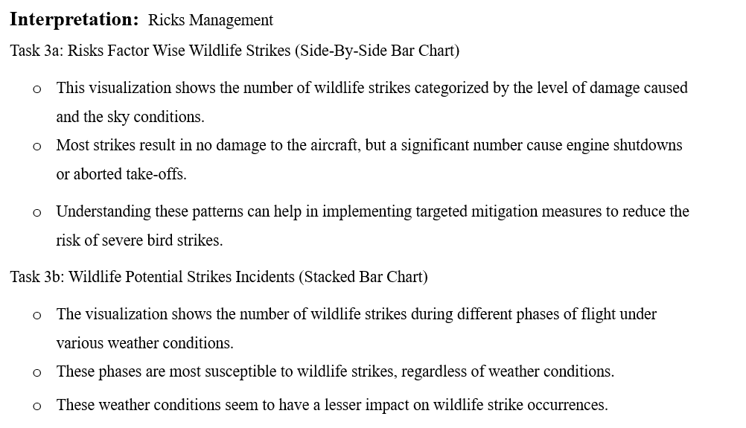

Slide 14
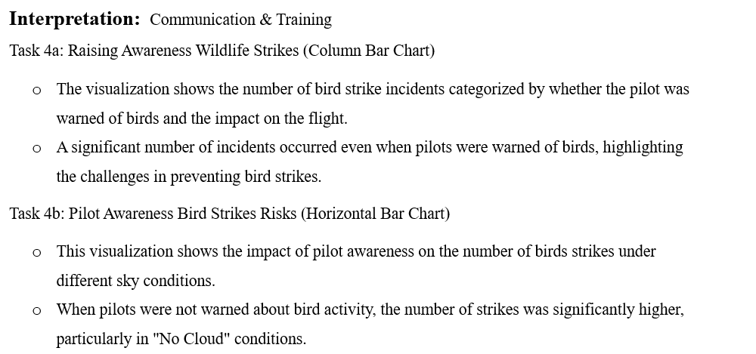

Slide 15
THANK YOU

